Slide 1
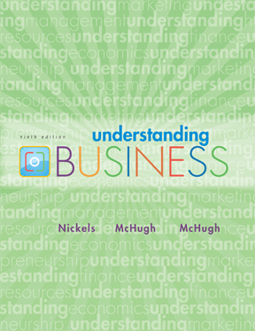


*
Chapter Eleven
*
Human Resource Management: Finding and Keeping the Best Employees
McGraw-Hill/Irwin
Copyright © 2010 by the McGraw-Hill Companies, Inc. All rights reserved.

Slide 2
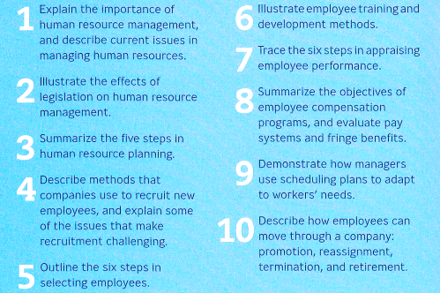
Learning Objectives
*
*
LG1
11-2
Notes:
See Learning Goal 1: Explain the importance of human resource management, and describe current issues in managing human resources.

Slide 3

DETERMINING FIRM’S HR NEEDS
*
Determining a Firm’s Human Resource Needs
*
LG3
Human resource planning
It is a process that identifies current and future human resources needs for an organization to achieve its goals.
Features
Future Oriented
Continuous Process
Optimum utilization of HR
Right kinds and numbers
Balance of demand & supply
Environmental influence
Part of corporate plan
11-3
Notes:
See Learning Goal 3: Summarize the five steps in human resource planning.

Slide 4
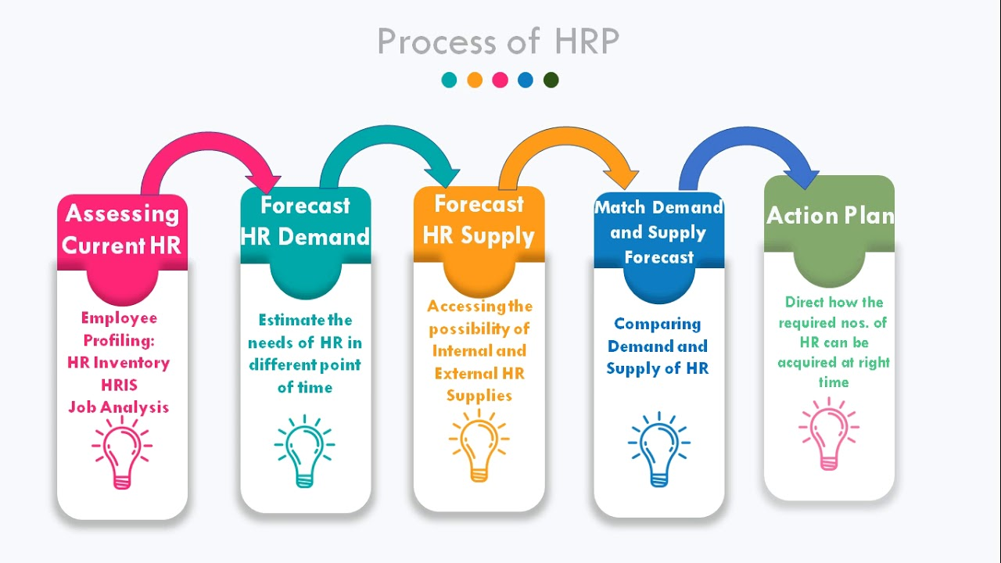
HUMAN RESOURCE PLANNING PROCESS
*
Determining a Firm’s Human Resource Needs
*
LG3
Preparing Job Analysis
Assessing future HR demand
Establishing a strategic plan
Preparing HR Inventory
Assessing future labor supply
Job Description
Job Specification
To cope up with technology changes
11-4
Notes:
See Learning Goal 3: Summarize the five steps in human resource planning.

Slide 5
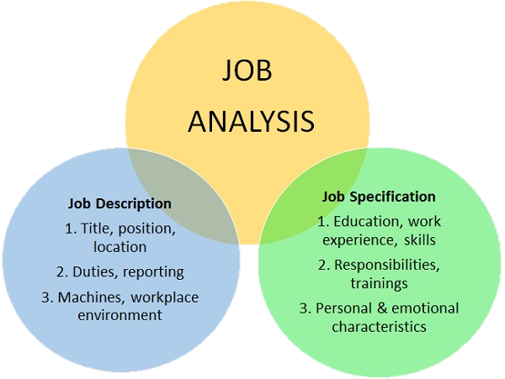
Job Analysis
*
Determining a Firm’s Human Resource Needs
*
Job Analysis -- A study of what employees who holds various job titles do.
It has two functions:
Job Description -- Specifies the objectives of the job, the type of work, the responsibilities and duties, working conditions and relationship to other jobs.
Job Specifications -- A summary of the minimal education and skills needed to do a particular job.
LG3
Notes:
See Learning Goal 3: Summarize the five steps in human resource planning.

Slide 6
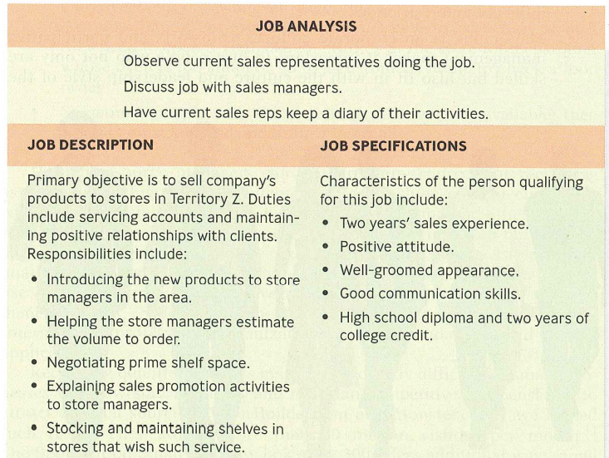
Sample Job Analysis
*
Determining a Firm’s Human Resource Needs
*
LG3
11-6
Notes:
See Learning Goal 3: Summarize the five steps in human resource planning.

Slide 7

Recruiting employees from diverse population
*
Recruiting Employees from a Diverse Population
*
LG4
Recruitment -- The set of activities for obtaining the right number of qualified people at the right time. It involves identifying, attracting, screening, shortlisting, and interviewing suitable candidates for jobs.
Recruiting from diverse population offer wider perspectives, knowledge and approaches to decision making.
11-7
Notes:
See Learning Goal 4: Describe methods that companies use to recruit new employees, and explain some of the issues that make recruitment challenging.

Slide 8

Challenges of recruiting employees
*
Recruiting Employees from a Diverse Population
*
Organizational policies may demand internal promotions;
Recruiting may be subject to external influence;
Nonexistence of employees perfectly fitting the organizational culture and leadership style;
Unavailability of employees with necessary skills from external sources;
Unapproachability of skilled employees due to lack of competitive packages by small firms.
LG4
11-8
Notes:
See Learning Goal 4: Describe methods that companies use to recruit new employees, and explain some of the issues that make recruitment challenging.

Slide 9
Internal VS External Recruitment
*
Recruiting Employees from a Diverse Population
*
LG4
Internal Employee | External Employee
Pros: Cost & time-effective Improves loyalty & morale Increase employee retention | Pros: Brings new ideas, experience and qualifications
Cons: Stagnant innovation & culture Create vacancy | Cons: - Limits understanding and adaptability - Creates disputes among more deserving existing staff
11-9
Notes:
See Learning Goal 4: Describe methods that companies use to recruit new employees, and explain some of the issues that make recruitment challenging.

Slide 10
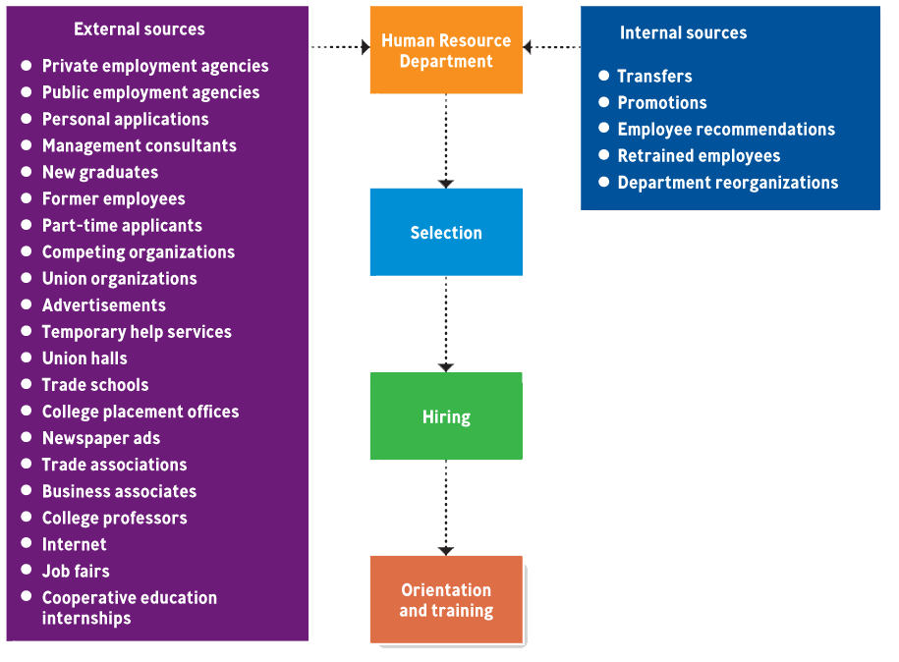
Recruitment sources
*
Recruiting Employees from a Diverse Population
*
LG4
11-10
Notes:
See Learning Goal 4: Describe methods that companies use to recruit new employees, and explain some of the issues that make recruitment challenging.
Job candidates can come from internal and external sources. In order to attract qualified employees from external sources many employers offer referral bonuses to employees who refer a new employee to the company.

Slide 11
Mini Activity
*
Recruiting Employees from a Diverse Population
*
LG4
Look at the classified ads on internet and find a position that you would like to have when you graduate. List the qualifications specified in the ad.
11-11
Notes:
See Learning Goal 4: Describe methods that companies use to recruit new employees, and explain some of the issues that make recruitment challenging.
Job candidates can come from internal and external sources. In order to attract qualified employees from external sources many employers offer referral bonuses to employees who refer a new employee to the company.

